Slide 1
Peyton’s Real and Pretend Story

Slide 2
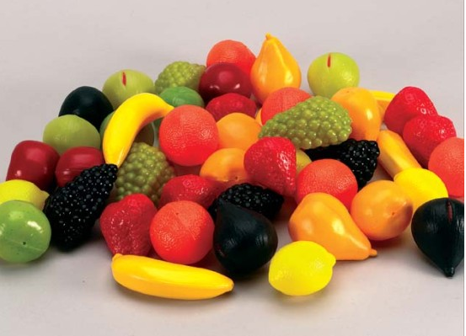
This story is about real and pretend. Pretend things are fake, make believe, or imaginary.
Real fruit Pretend fruit

Slide 3
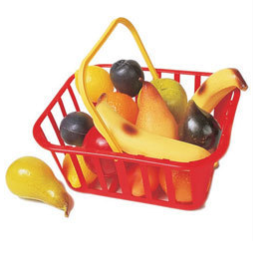
This is pretend fruit. It is fun to use when you play shopping. It is plastic fruit and you can’t eat it. It is hard and yucky to taste because it is pretending to be fruit.
Pretend
fruit

Slide 4
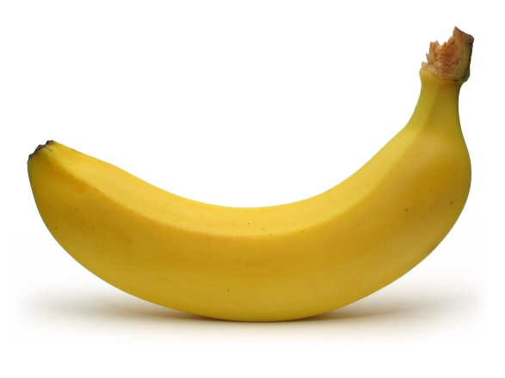
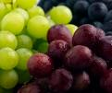
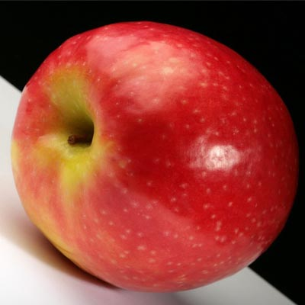
This is real fruit. You can really eat it. When you bite into it, you can chew it. It tastes good.
Real fruit

Slide 5
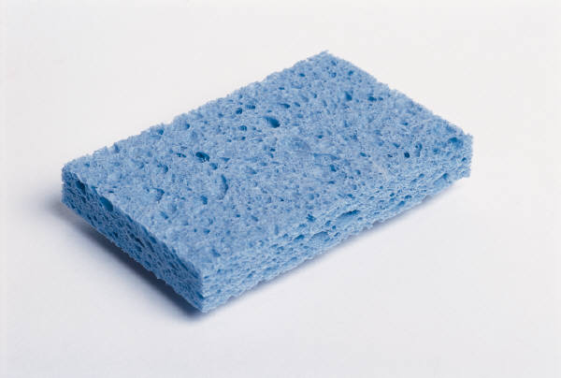
This is a real sponge. It wipes up water. We use it to wash dishes.

Slide 6
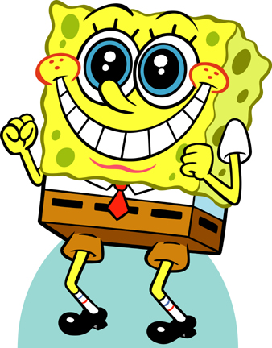
This is Sponge Bob. He is pretend. He can’t really wipe up water but he does funny things! We see him on TV, books, and movies.

Slide 7
This is a real mouse. It breathes and eats. It runs around. It doesn’t need anything to help it move.

Slide 8
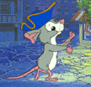
This is a pretend mouse. We see it in books, in movies, and on TV. This mouse is found in books, TV, or a movie because it isn’t real.

Slide 9
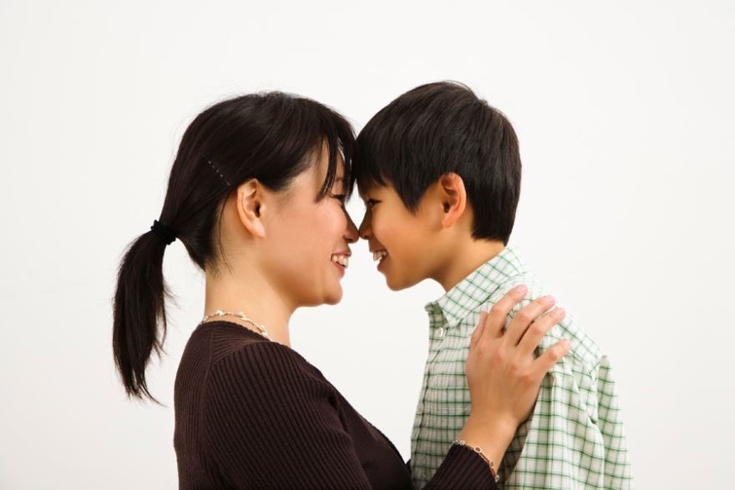
Pretend things are fake, make believe, or imaginary. Some things on TV, movies and in books are real. Some things on TV, movies and in books are pretend.

Slide 10
Cartoon characters are so much fun! Cartoons are pretend.

Slide 11
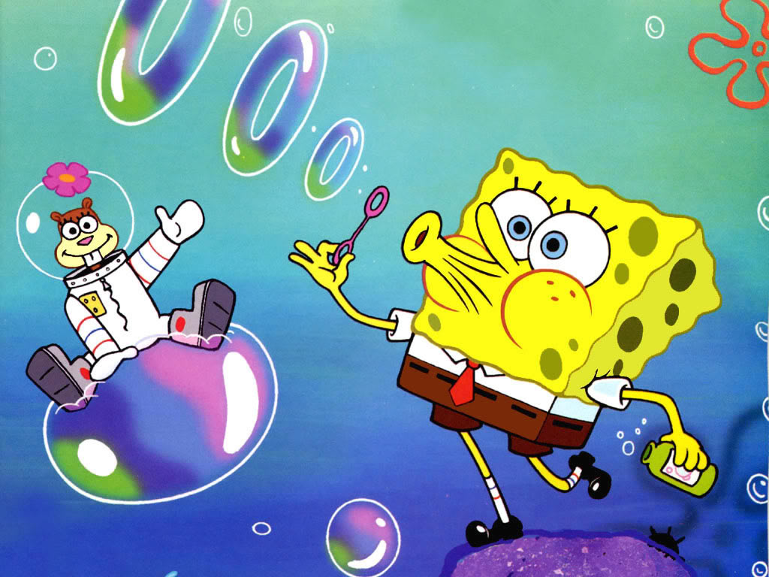
We see cartoons in books, TV, and movies. They are pretend. They do lots of funny and interesting things. They do lots of things that are not real but its fun to pretend.

Slide 12
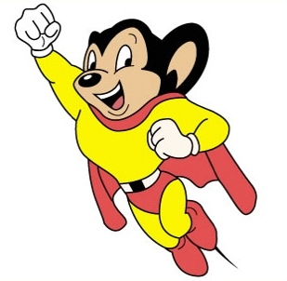
This mouse if flying. A real mouse doesn’t fly. It is pretend.

Slide 13
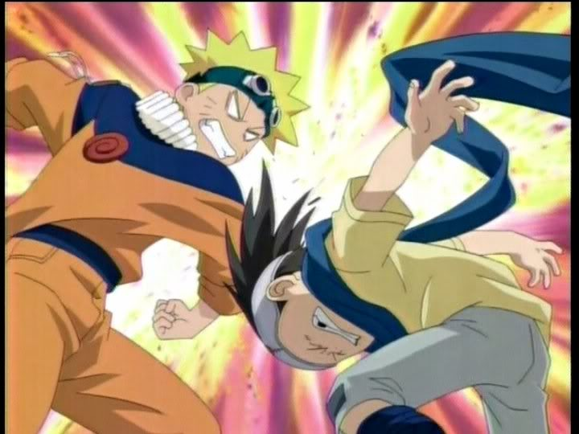
Sometime cartoon people hit each other. Because cartoons are pretend, we shouldn’t copy what they do.

Slide 14
When cartoon people hit, it is pretend.

Slide 15
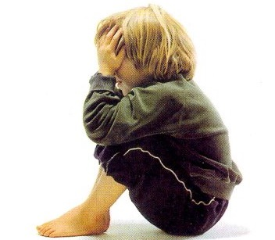
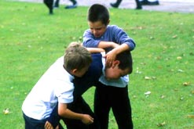
When real people hit, it hurts. This makes people sad and even cry!

Slide 16
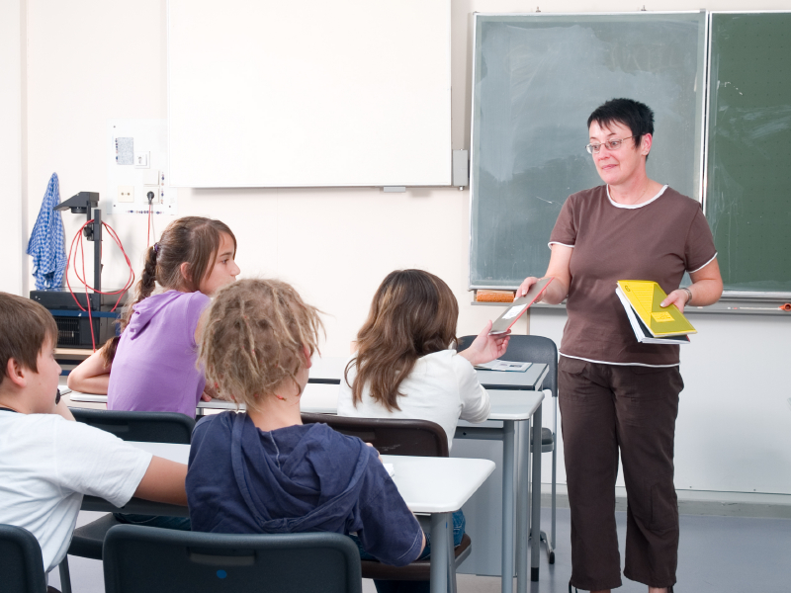
I should follow rules that come from real people like my teacher, my mother or my grandmother.

Slide 17
No hitting is always a good rule. This way I know I won’t hurt anyone or make them sad.

